Slide 1
Welcome to CHP-DP Introduction Session
While You Wait for the Session to Begin
Enter your name on your individual video panel.
Please turn on your video camera if you are comfortable being onscreen.
Use the chat box to answer this question:
What is your favored Food?

Slide 2
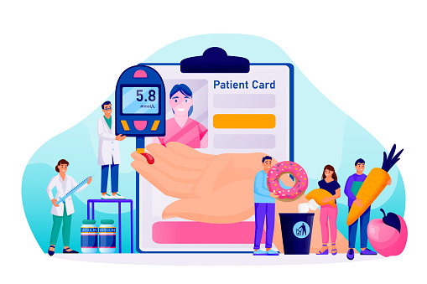
Session 1 National Diabetes Prevention Program’s Lifestyle Change Program
Date: Sunday, September 18th, 2022
Facilitator: Nahila Ayeva, BS, MA, CHES, LCC- DPP

Slide 3
Introductions
And now for some introductions.
You’re on the way to discovering a healthier you—and the people around you will help you get there!

Slide 4
5 Goals for Today’s Session
Learn about the type 2 diabetes, prediabetes, and the National Diabetes Prevention Program (National DPP).
Learn how our Community Health Promotion Diabetes Prevention (CHP-DP) here at Womens Health First, can help you reduce your risk of developing type 2 diabetes.
Discover some things about yourself and your readiness to make a lifestyle change.
Meet some great people.
Have fun!

Slide 5
What You Value and the Choices You Make
1. Select one value that is most important to you:
2. Describe a recent experience when you demonstrated this value. Use the Discovery Session Values Affirmation Worksheet or a blank piece of paper to briefly describe it.
Values
Friendship
Community
Family
Career
Humor
Gratitude
Faith, Religion, or Spirituality

Slide 6
Overview of the National DPP Lifestyle Change Program

Slide 7
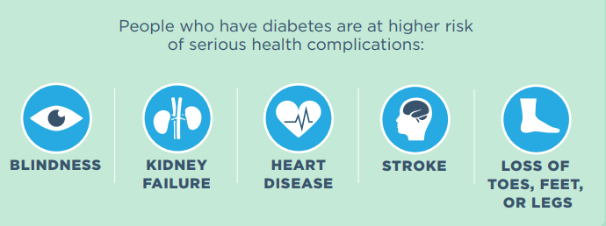
If you have type 2 diabetes…
Your body cannot properly use insulin, which could cause you to have high blood sugar levels.

Slide 8
Type 2 Diabetes
You are at higher risk for type 2 diabetes if you:
Are 45+ years old
Are not
physically active
Are overweight
Have a parent or sibling with type 2 diabetes
Had diabetes while pregnant
(gestational diabetes) or a baby weighing 9+ pounds at birth

Slide 9
Have you heard of prediabetes?

Slide 10
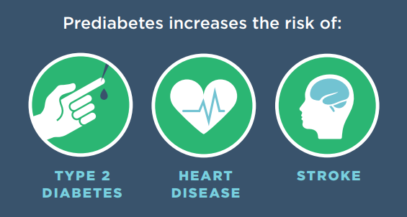
If you have prediabetes…
Your blood sugar levels are higher than normal,
but not high enough for a type 2 diabetes diagnosis.

Slide 12
National Diabetes Prevention Program
(National DPP)

Slide 13
Womens Health First/ Community Health Promotion Diabetes Prevention (CHP-DP)

Slide 14
CHP-DP at Womens Health First
Goals of the Lifestyle Change Program
Reduce body weight by 5% to 7%.
Increase physical activity to 150 minutes each week (20-30 m/d)
Increase coping skills.
What Our Program Offers
Proven curriculum (CDC)
Lifestyle coach.
Support group.

Slide 15
CHP-DP Program at Womens Health First
You can join the program if you:
Are 18 or older.
Are overweight (BMI >25 or >23 for people of Asian heritage).
Have prediabetes:
Recent blood test.
High-risk score on the Prediabetes Risk Test.

Slide 16
Prediabetes Risk Test
Take the prediabetes risk test at
www.cdc.gov/diabetes/risktest/index.html
or www.cdc.gov/diabetes/prevention/pdf/Prediabetes-Risk-Test-Final.pdf
Click on the link in the chart or ASHA Test Message…)

Slide 17
What If You’re Not Eligible?
You are not eligible for this program if you:
Got a low-risk score on the Prediabetes Risk Test.
Are pregnant.
Have been diagnosed with type 1 or type 2 diabetes.
If you’re not eligible, we can email you information to help you manage your condition and make healthy lifestyle changes.

Slide 18
CHP-DP
Within 12 months, you and your group will make amazing progress!
Next class:
Sunday, October 2nd , 2022
From 4:00 – 5:00 PM
ON ZOOM
Program costs:
This Program is at NO cost to you

Slide 19
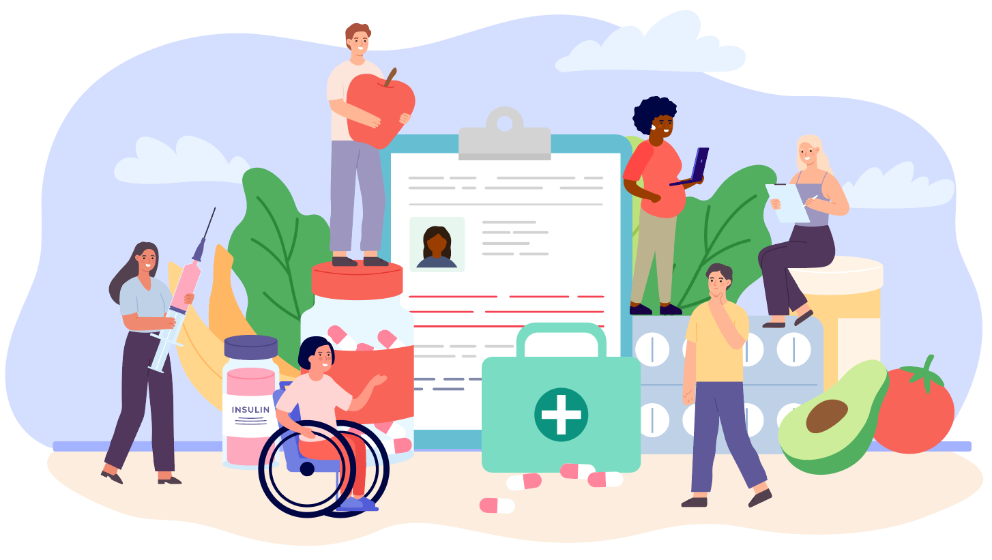
Participant Testimonials
What you will gain from being part of this program…

Slide 21
Collaborative Commitment Activity
Question 1:
How can you add regular physical activity, like walking or climbing steps, to your everyday life?

Slide 22
Collaborative Commitment Activity
Question 2:
How would enrolling in this program fit with the important value you chose at the beginning of the session?

Slide 23
Session Wrap Up: Are you ready for the next step?
Our next class starts
Sunday, October 2nd, 2022
From 4:00 – 5:00 PM
ON ZOOM

Slide 24
Ask yourself the following question:
Starting today, how can I improve my health and lower my risk of developing type 2 diabetes?

Slide 25
If you’re eligible, let’s get you enrolled!
Our DP Lifestyle Change Program Session One is:
Sunday, October 2nd, 2022
From 4:00 – 5:00 PM
ON ZOOM
ID:916 987 5289 Password: ASHA
Tel: 678-777-8961
info@womenshealthfirst.org
womenshealthfirst.org

Slide 26
THANK YOU!
Congratulations for taking…

